Slide 1
MULTIMEDIA OVER WIRELESS BROADBAND NETWORKS

Slide 2
Definition:
Multimedia over wireless broadband is an emerging service that integrates voice, video and data in the same service. For example songs, movies, games are considered to be different forms of multimedia.
Example of a wireless handheld device supporting multimedia is a, Personal Data Assistant (PDA), it can integrate voice, video, and data in one device. A camera mobile phones is another example.

Slide 3
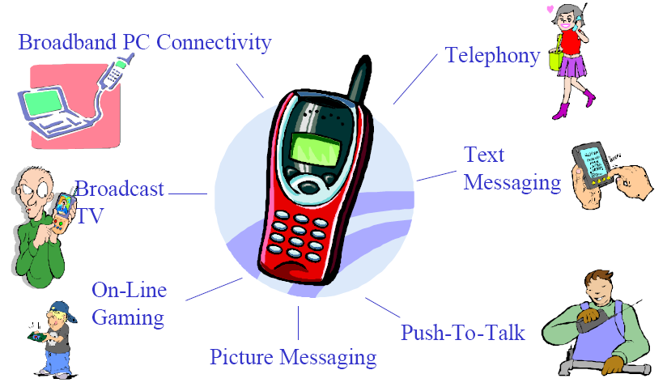
Examples of multimedia

Slide 4
Applications using multimedia:
Remote education
video-on-demand
Teleshopping
Home games
Entertainment (Movies, Songs)

Slide 5
Transmission of real-time data over wireless broadband network indicates delivery of multimedia along traditional data traffic which is extremely dense and heavy.
The system required for this kind of support must be capable of providing
1. Quality of Service (QoS) for voice and video packets.
2. Use the available bandwidth to the maximum
The transmission quality of radio is easily affected by environments such as buildings, moving objects, and atmosphere, etc. Moreover, because of the mobile nature of the users, the access point of a mobile user changes continuously. All these factors in wireless networks give rise to issues such as effective bandwidth allocation, high channel bit error rate, and user handover

Slide 6
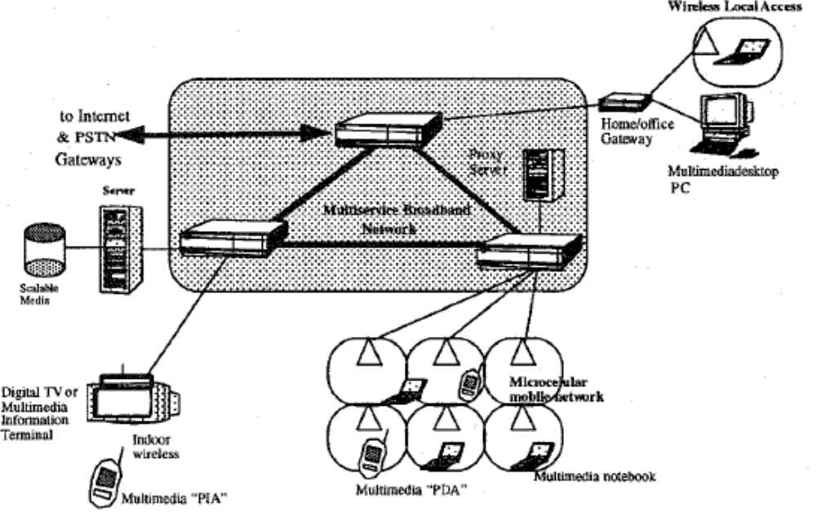
Integrated Network (Broadband + Mobile)

Slide 7
Methodology explaining end-to-end Transmission over wireless network:
To provide efficient communication and quality of media content sent
over, the system consists of three major components:
1.anyDevice
2.Center Server
3.Agent Server

Slide 8
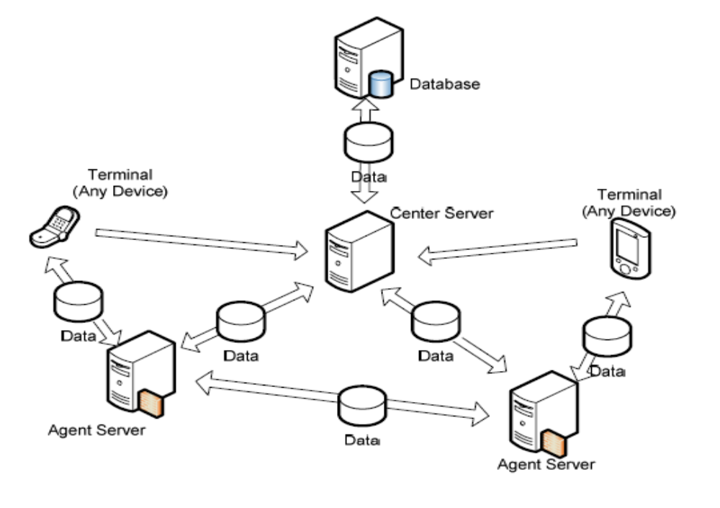
Network architecture Diagram:

Slide 9
1. anyDevice is a client-side protocol stack working on terminals and it helps terminals to communicate with servers. It is also responsible for communication control, data transmission between terminals and servers, and user profile management.
2. Center Server provides indexing and database services and is responsible for session management. It helps terminals to quickly restart data transmission
3. Agent Server provides data buffering and multimedia transcoding services. The former prevents transmitters retransfer lost data during network congestion or disconnection. The latter helps heterogeneous terminals communicate with each other seamlessly and efficiently.

Slide 10
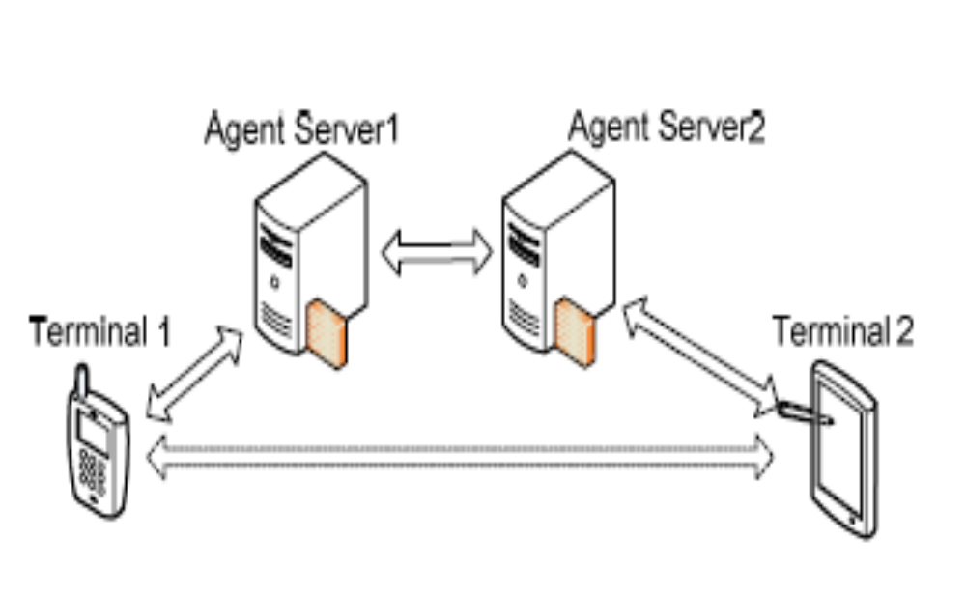
Communication between terminals and agent Server:

Slide 11
Advantages:
Dramatically lower in cost
Always on
Anytime, anywhere and in any form
Voice and multimedia
Self service, intuitive
Simpler for the end user

Slide 12
Problems accessing Multimedia :
Limited bandwidth of wireless networks.
Limited capabilities and limited Resources of wireless terminals.
Diversity of wireless terminals.
Fluctuated Bandwidth and Blackouts of wireless connections.
These are major problems for the efficient transmission of multimedia flows.

Slide 13
To run multimedia over broadband network, several issues are to be addressed:
Transmission must be real-time and maintain good quality of service for the real time traffic which is extremely dense and heavy.
Storage compression and decompression must be efficient to utilize limited bandwidth efficiently.
RTP is used to transmit real time data over IP and MPEG video coding is used to obtain high video quality which is accepted even when bandwidth decreases to 56kbps.

Slide 14
Real time transmission:
To transmit real time data on network, a protocol must provide end to end real time data delivery and satisfy the following constraints.
1.Regulation between server and client.
2.Capacity to solve asynchrony caused by the network
3.Capacity to synchronize between data streams.
4.Ability to give priority to one type of media over the other
5.Informs sub-layer about the type of information contained in the packets.
6.Allows multiplexing and demultiplexing different types of information along with synchronization.

Slide 15
RTP:
To ensure end to end real time data delivery we use RTP. The services provided by RTP include
1.Packet loss detection
2.Security and Content identification.
3.Sequence numbering
4.Timestamping

Slide 16
RTP contd…
Real-time Transport Protocol (RTP) is the protocol designed to handle real-time traffic on the Internet. RTP does not have a delivery mechanism (multicasting, port numbers, and so on); it must be used with UDP. RTP stands between UDP and the multimedia application. The literature and standards treat RTP as the transport protocol (not a transport-layer protocol) that can be thought of as located in the application layer
(see Figure 1).
Notes:
28.#

Slide 17
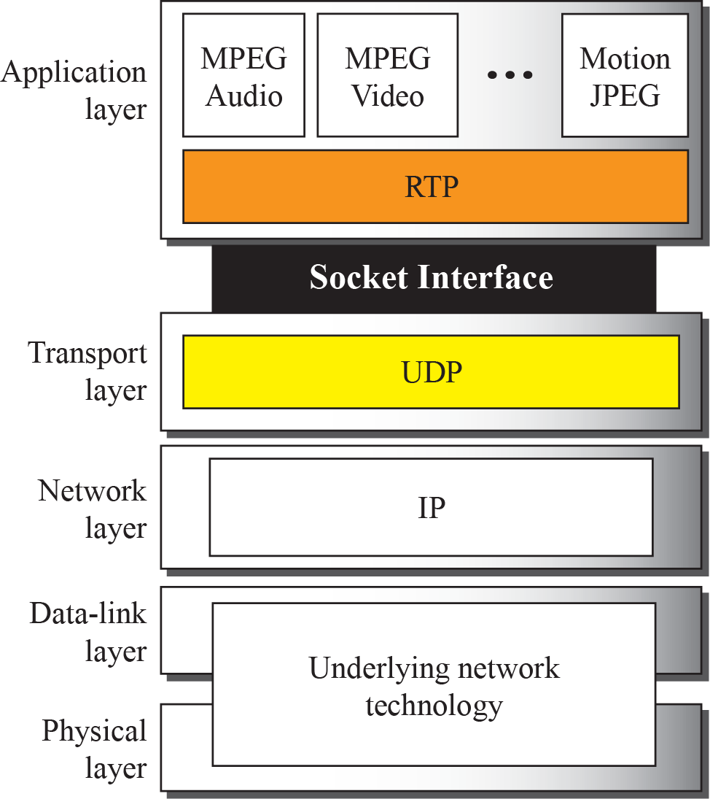
Figure 1 : RTP location in the TCP/IP protocol suite
Notes:
28.#

Slide 18
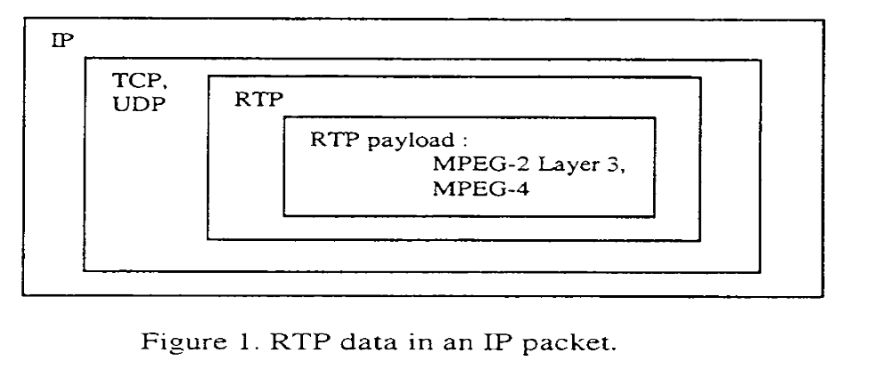
Sequence numbers are used to order incoming packets and to detect packet losses.
Time stamping is a very important information for real time applications.
A payload type identifier specifies the payload format as well as the encoding/compression schemes.

Slide 19
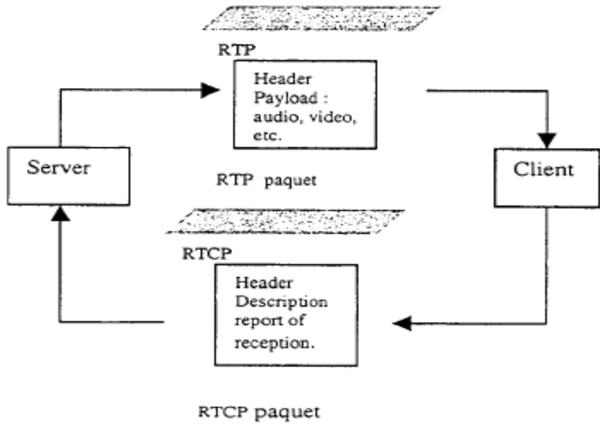
RTCP:
RTCP is a second protocol of RTP which transfer the control traffic.
It sends the transmitter about the quality of transmission.

Slide 20
RTCP which provides control information to transmitter provides following services.
1.QoS monitoring and congestion control
2.Source identification.
3.inter-media synchronization
4.Control information scaling

Slide 21
RTCP contd..
RTP allows only one type of message, one that carries data from the source to the destination. To really control the session, we need more communication between the participants in a session. Control communication in this case is assigned to a separate protocol called Real-time Transport Control Protocol (RTCP).
Notes:
28.#

Slide 22
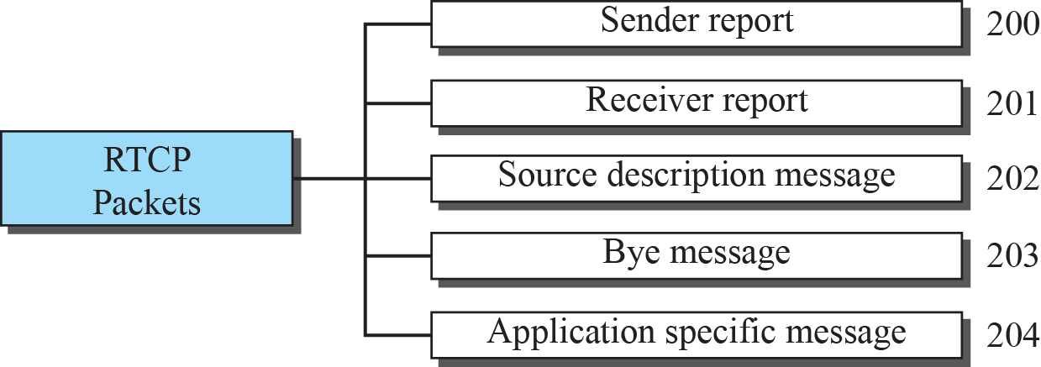
Figure 2: RTCP packet types
Notes:
28.#

